Slide 1
Capstone Project: Analysis of Stock price and forecasting using LSTM
Rezoan Ahmed Shuvro

Slide 2
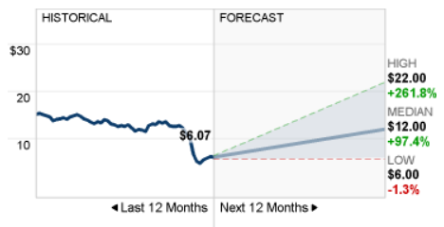
Objective
To perform exploratory data analysis to observe various stock price trend and analyze the stock price behavior of different stocks.
To develop a simple LSTM based model for predicting the upward/downward trend for a stock using historical stock price data and predict future stock price.
Energy transfer stock prediction (source: CNN)

Slide 3
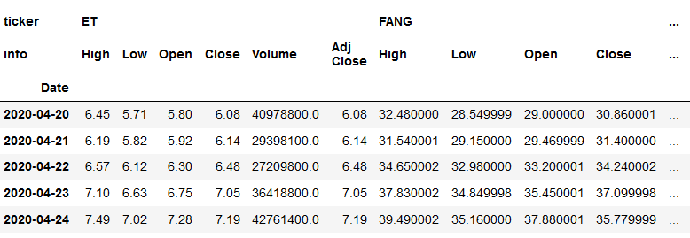
Data collection
Used pandas datareader API to scrap stock prices data from ‘yahoo’
Data was then manipulated to create the following DataFrame where:
rows represents time series of date
Columns represent a hierarchical table of stock tickers and prices info

Slide 4
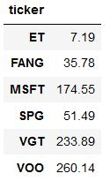
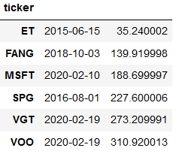
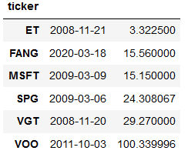
Data analysis
pd.merge(pd.DataFrame(my_stocks.xs(key='Close',axis=1,level='info').idxmax()), pd.DataFrame(my_stocks.xs(key='Close',axis=1,level='info').max()),on='ticker')
pd.merge(pd.DataFrame(my_stocks.xs(key='Close',axis=1,level='info').idxmin()), pd.DataFrame(my_stocks.xs(key='Close',axis=1,level='info').min()),on='ticker')
Last day’s price
All time high
All time low
SPG, FANG, ET are close to their all time low
MSFT,VOO, VGT are very close to their all time high

Slide 5
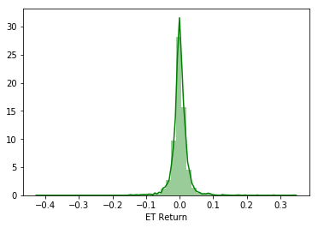
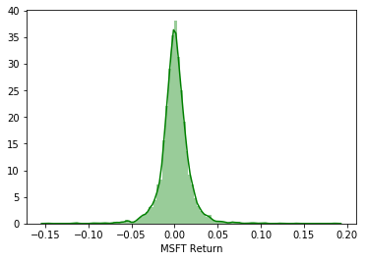
Data analysis
- Distribution plot of the standard deviation of the return (calculated using the percentage change) indicates that ET stock is more fluctuations in prices compared to MSFT

Slide 6
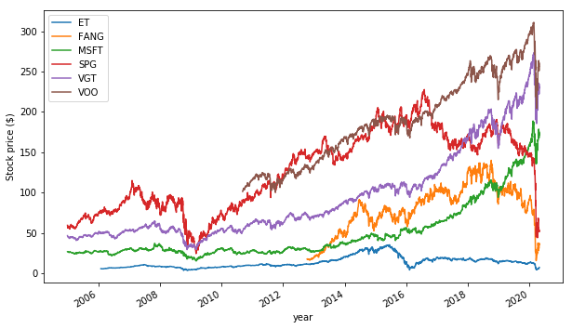
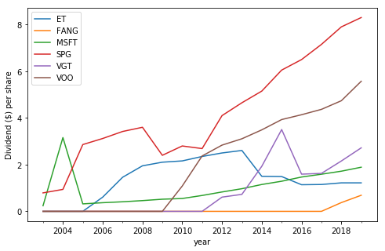
Stock price and dividend over time
Stock price
Dividend
- SPG, MSFT, VOO are very stable dividend payers. While ET pays dividend at a decent ratio, but the dividend is not growing

Slide 7
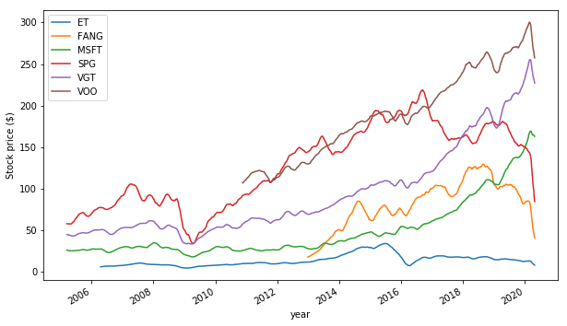
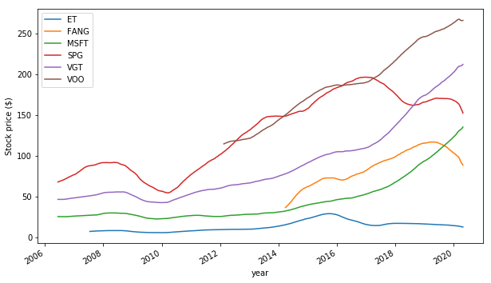
Smoothing the variance of the stock prices
50 day rolling average
365 day rolling average
Time series of the 50 day and 365 day rolling average gives a high-level idea about the stock type.
For example, MSFT is a still growing (growth stock)
Energy transfer pays dividends to the share holders. It’s a dividend stock

Slide 8
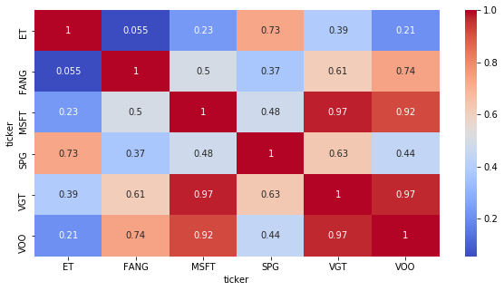
Correlation between stock price
- Correlation between stocks can be used to identify similar stocks. For example VGT (technology index and VOO (S&P 500 index are heavily correlated))
- To enhance diversity of the portfolio, avoid investing all of your investments in the same bucket

Slide 9
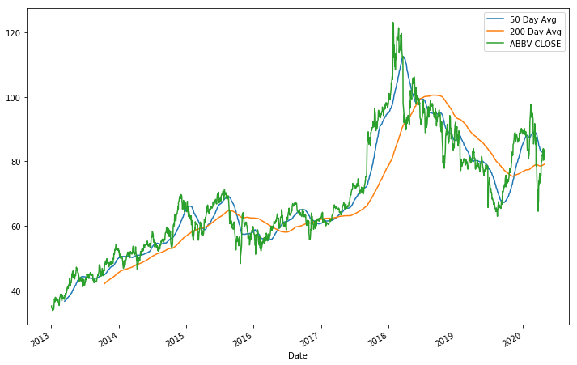
50 Day moving avg vs 200 day moving Avg.
bearish
bullish
- When 50day moving average cuts the 200day moving average, it is called the golden cross
- 50day moving average cuts the 200day moving average and the slop is positive, it’s a bullish signal (buy)
- 50day moving average cuts the 200day moving average and the slop is positive, it’s a bearish signal (sell)
The figure above for the ticker ‘ABBV’ (a pharmaceutical stock) validates the above-mentioned fact

